Slide 1
The impact of MiFID on retail investors

Slide 2
Agenda
Impact of MiFID on the retail investors, Guillaume Prache, Managing Director of EuroInvestors
Conclusions of the study conducted by Equiduct, Peter Randall, CEO of Equiduct Systems Limited
Q&A

Slide 3
Access to Real Time Data

Slide 4
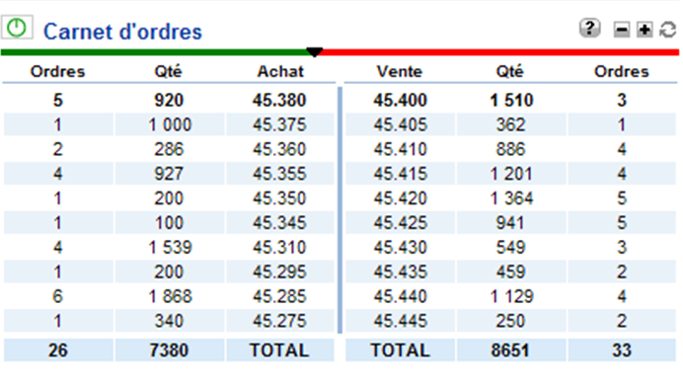
Example
Stock name: Societe Generale
Time and Date of the Screenshot : January 13th – 13:49:14.915 (CET)
Below: order book available on an online broker’s website

Slide 5
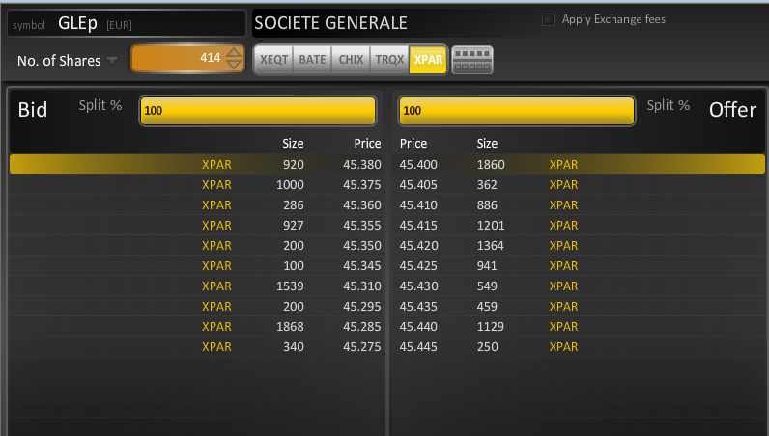
Example
Stock name: Societe Generale
Time and Date of the Screenshot : January 13th – 13:49:14.915 (CET)
Below: view of the Home Market order book

Slide 6
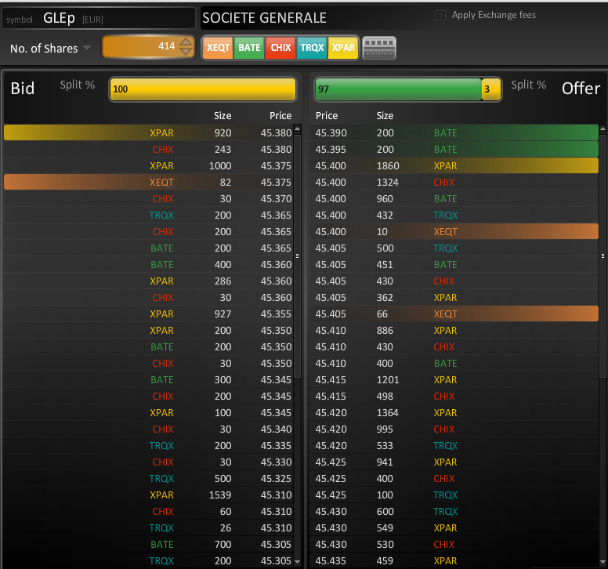
Example
View of the consolidated order book
A broker online connected to the Home Market would have missed the Best European Offer Price available at that exact time on BATS.

Slide 7
Cost of Opportunity

Slide 8
Example 1: AGEAS
Number of venues where the stock is tradable during continuous : 5
% of executed value missing the best price on another venue: 8.9%
% of trades missing the best price on another venue: 8.6%
% of trades executed on the home market missing the best price on another venue: 9.2%
Total Value Improvement for January 13th : 1,788 €
Average Price Improvement for trades missing the best price: 2.9 € - 7.5 Bps per trade
Average Price Improvement for trades executed on the HM missing the best price: 3.2 € - 7.6 Bps

Slide 9
Example 2: ENI
Number of venues where the stock is tradable during continuous : 6
% of executed value missing the best price on another venue: 10.04%
% of trades missing the best price on another venue: 10.2%
% of trades executed on the home market missing the best price on another venue: 16.3%
Total Value Improvement for January 13th : 12,895 €
Average Price Improvement for trades missing the best price: 4.4 € - 3.5 Bps per trade
Average Price Improvement for trades executed on the HM missing the best price: 4.3 € - 3.2 Bps

Slide 10
Example 3: SIEMENS
Number of venues where the stock is tradable during continuous : 6
% of executed value missing the best price on another venue: 16.1%
% of trades missing the best price on another venue: 15.9%
% of trades executed on the home market missing the best price on another venue: 14.1%
Total Value Improvement for January 13th : 7,329 €
Average Price Improvement for trades missing the best price: 1.8 € - 2 Bps per trade
Average Price Improvement for trades executed on the HM missing the best price: 1.9 € - 1.1 Bps

Slide 11
Example 4: SOCIETE GENERALE
Number of venues where the stock is tradable during continuous : 5
% of executed value missing the best price on another venue: 15.8%
% of trades missing the best price on another venue: 16.5%
% of trades executed on the home market missing the best price on another venue: 19.3%
Total Value Improvement for January 13th : 16,770 €
Average Price Improvement for trades missing the best price: 1.8 € - 2.5 Bps per trade
Average Price Improvement for trades executed on the HM missing the best price: 1.9 € - 2.7 Bps

Slide 12
Conclusions
Brokers only displaying information from the Home Market would miss between 20-40% of the liquidity available on other venues
It results in a cost of opportunity to the investors who have no access to it
Between 10-20% of the trades executed on the Home Markets could have achieved a better price on another venue
The cost of opportunity in 2010 for trades on the most liquid stocks missing the best price = 136M€
It is supported mostly by retail investors because retail brokers are mainly only connected to Home Markets
➔ MiFID has introduced competition to the equity market but the benefit of that competition are not available to the retail investors

